Slide 1
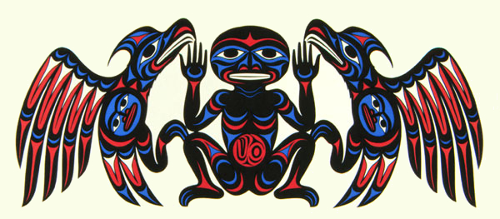
Coast Salish Art and Animals
Joe Wilson

Slide 2
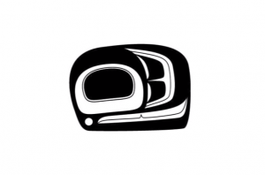
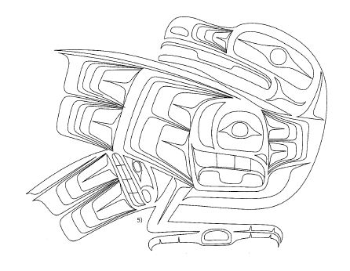
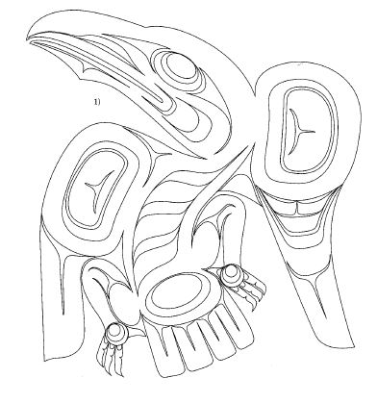
Raven by Ben Houstie, Bella Bella
The Ovoid and U-forms seen above are common to many Northwest Coast groups, and in particular, associated with the Haida, but now used frequently by Coast Salish artists as well.
Raven by Francis Horne Sr., Coast Salish

Slide 3
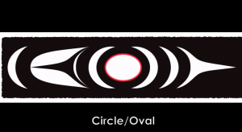
The circle, trigons, and crescents are unique to Coast Salish art and carvings

Slide 4
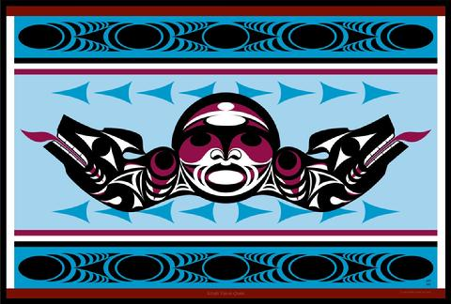
Joe Jack

Slide 5
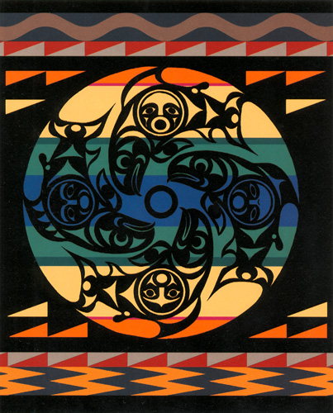
“The Salmon People”
Susan point

Slide 6
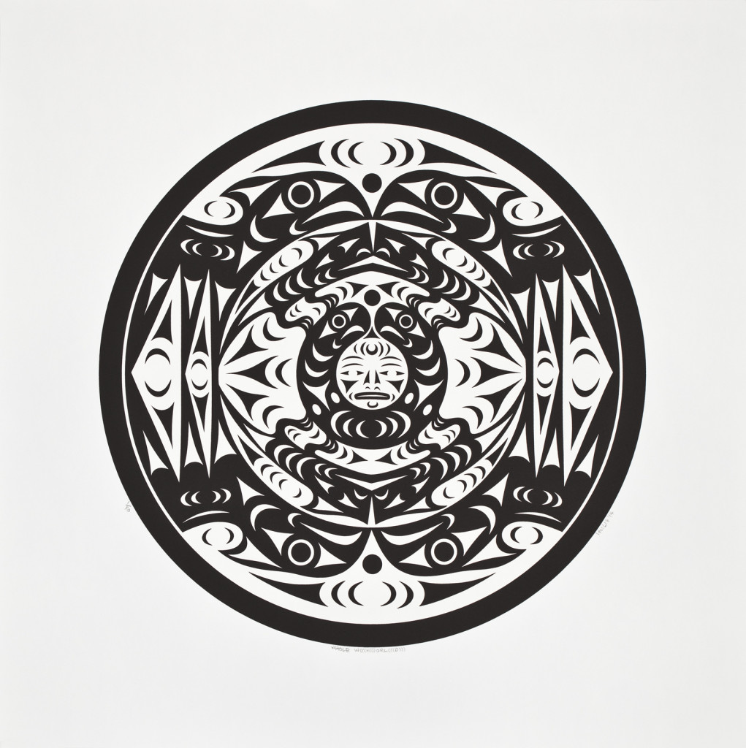
WHOLE W(((H)))ORL(((D))), LESSLIE

Slide 7
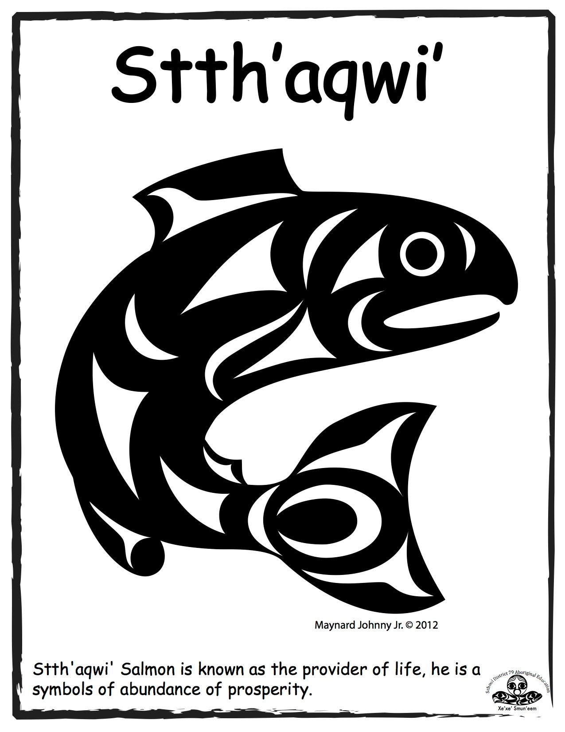
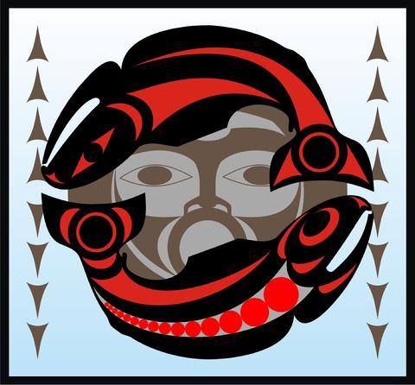
stseelhtun
Joe Jack

Slide 8
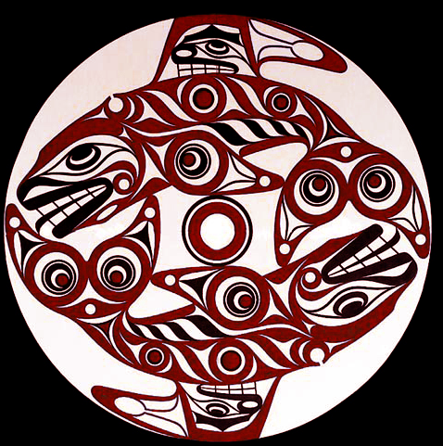
qwunus
Joe Wilson

Slide 9
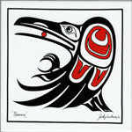
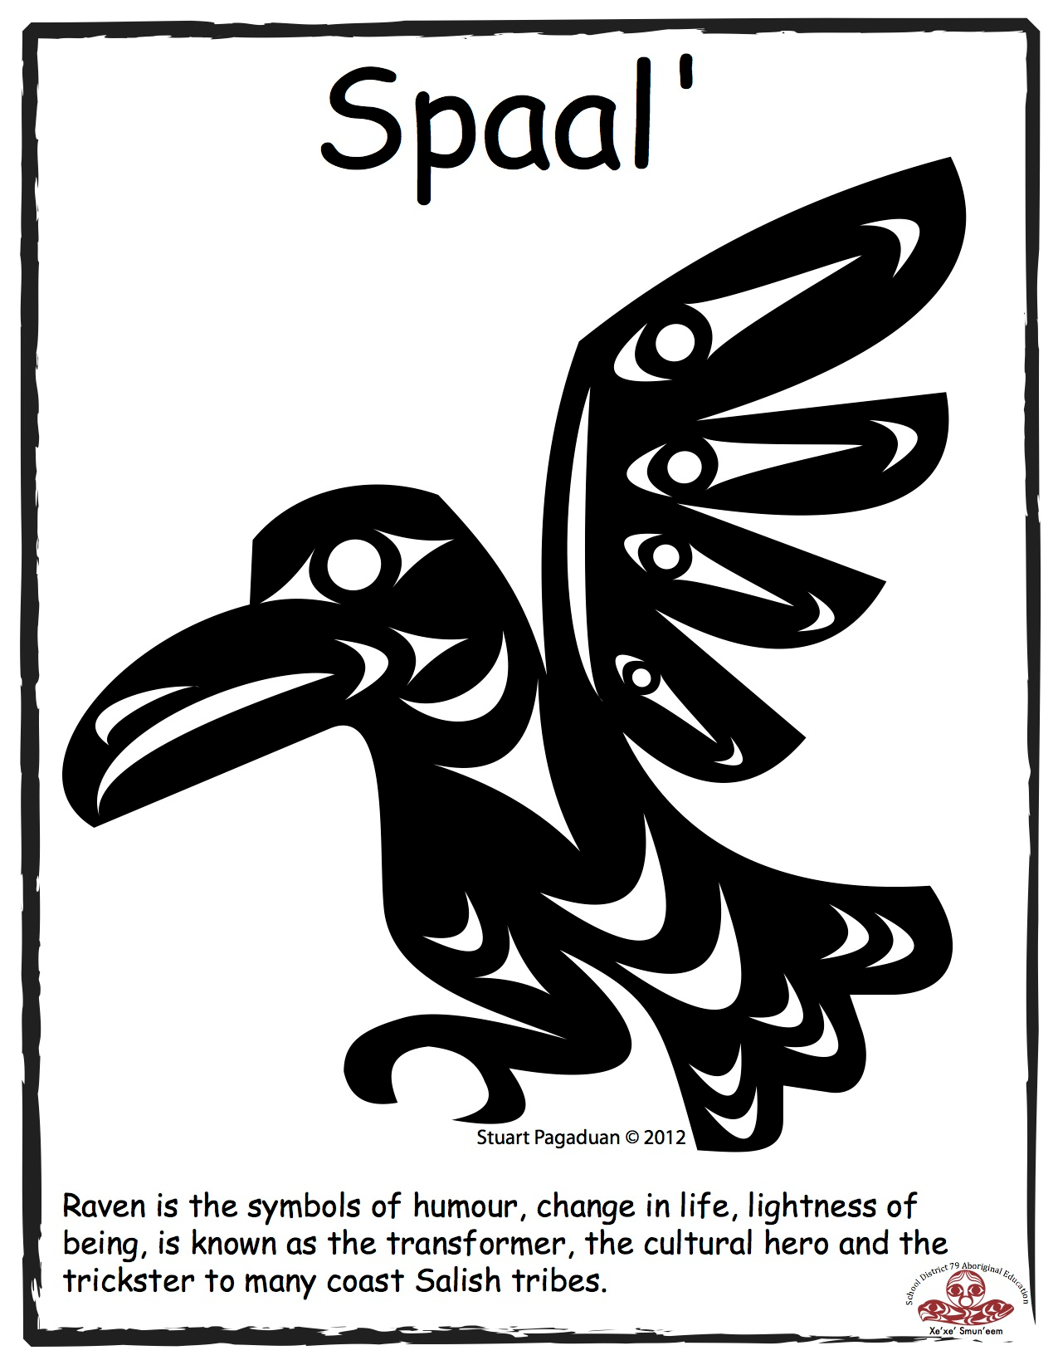
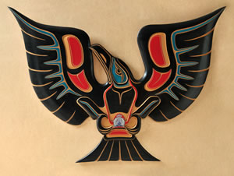
Jody Wilson

Slide 10
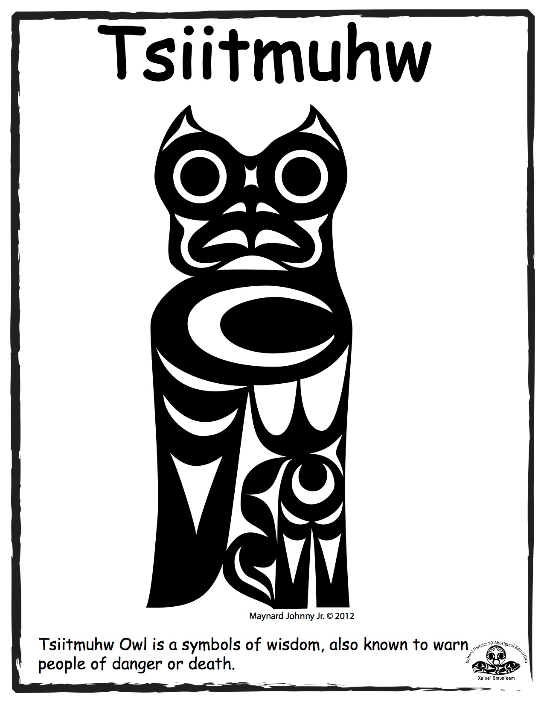
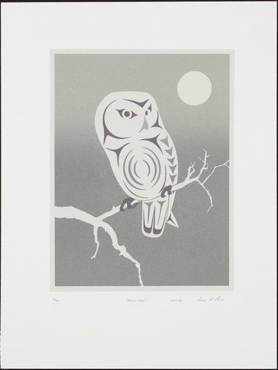
Susan Point
Glen Rabena

Slide 11
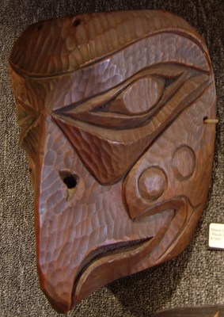
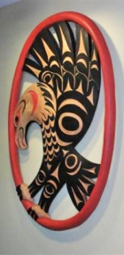
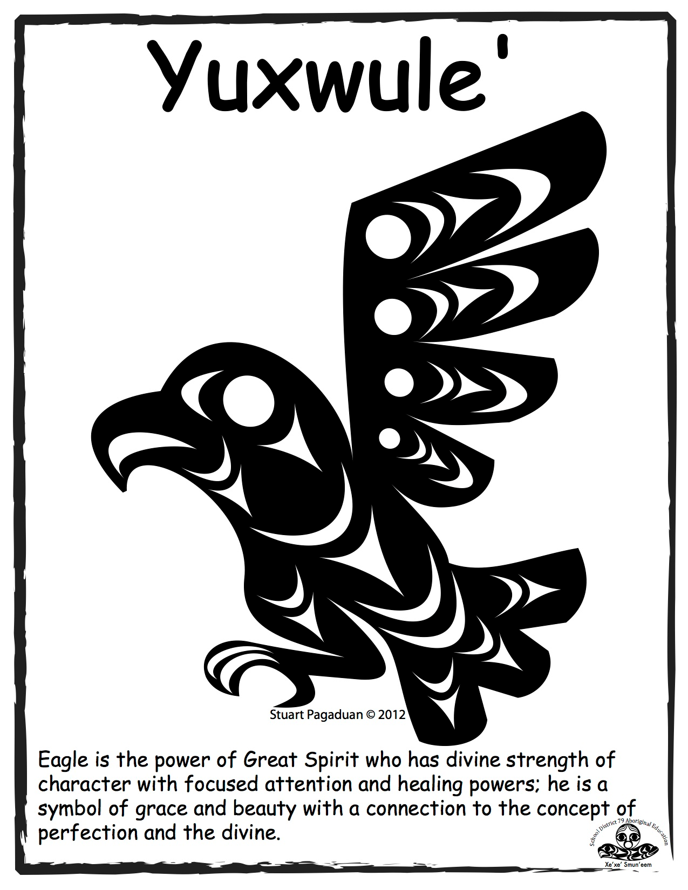
Simon Charlie
Charles Elliot

Slide 12
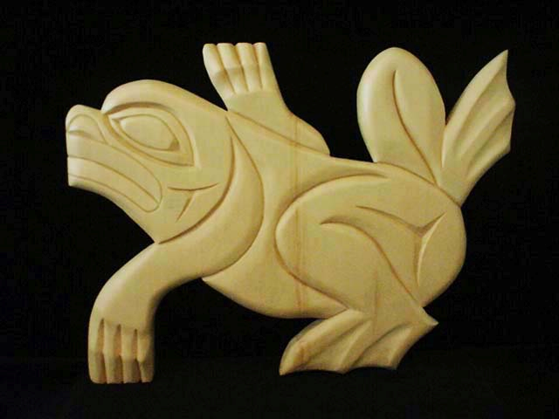
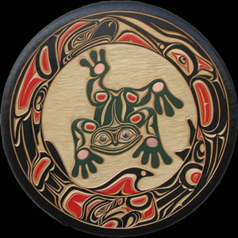
Doug La Fortune
Jody Wilson

Slide 13
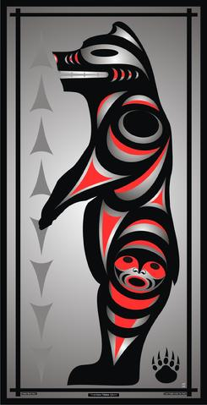
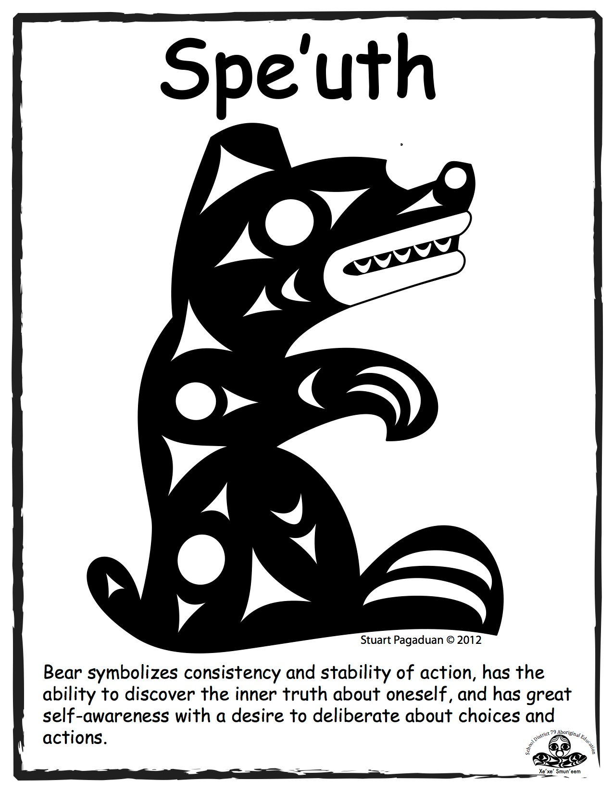
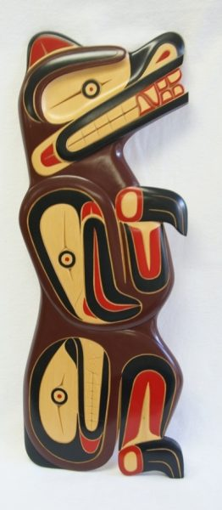
Joe Jack
Richard White Eagle

Slide 14
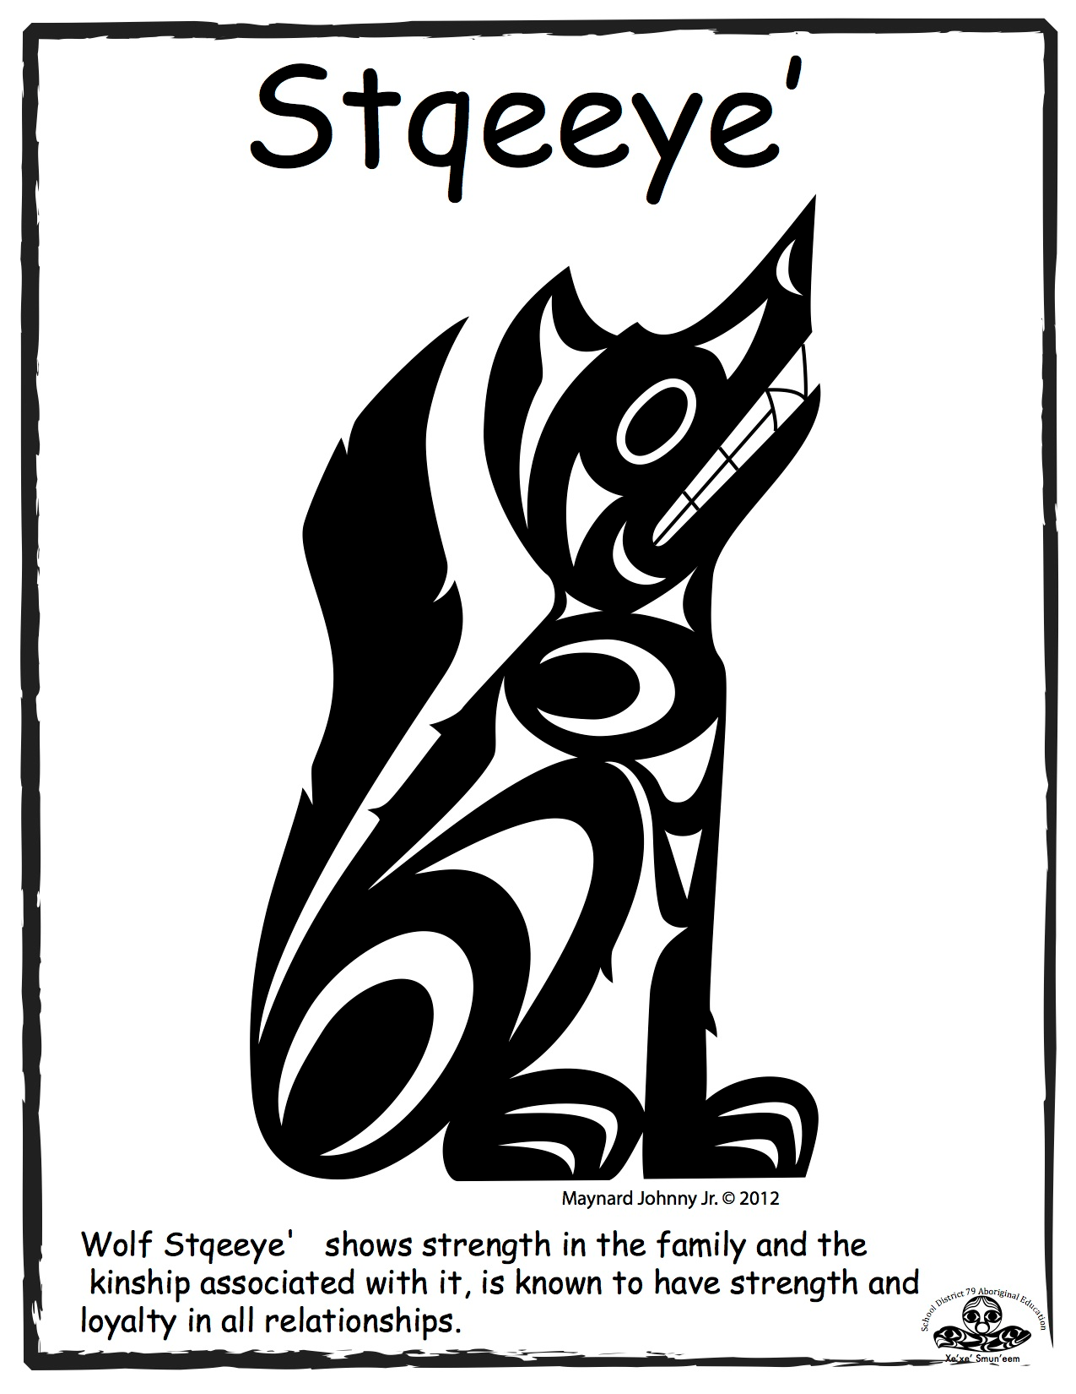
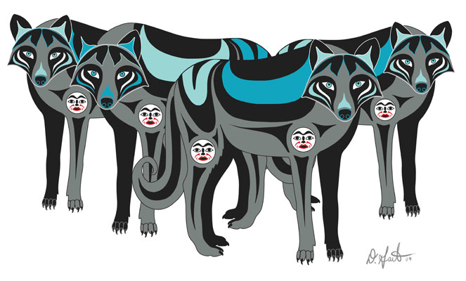
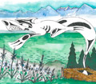
Darlene Gait
Butch Dick

Slide 15
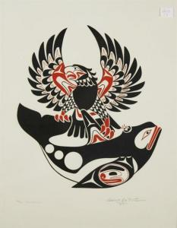
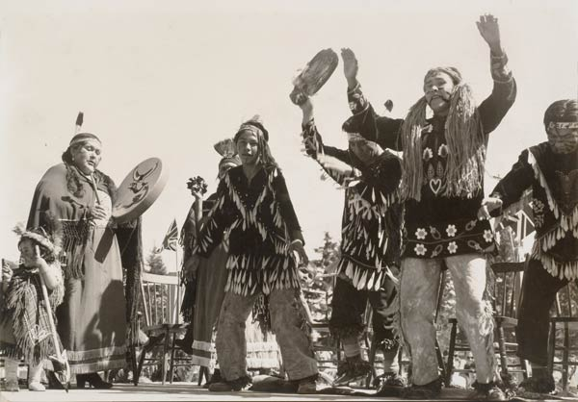
Doug La Fortune
Tzinquaw

Slide 16
Totem Activity
In groups of 2-3, look at your totem pole -
1.What animals or figures can you see?
2. Make a guess: What is the message, story, or intention behind the pole?
3.Explanations (not yours), Read the explanation, find your other half - who has that pole and the explanation to your pole?
4.Compare with the other group your guesses and explanations

