Slide 1
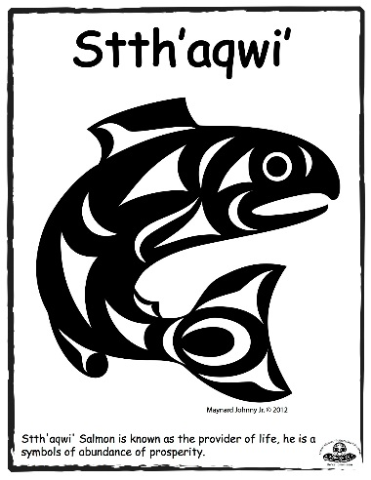
Salmon
Brother Rick Peter

Slide 2
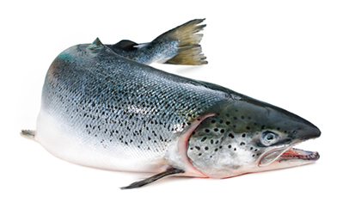
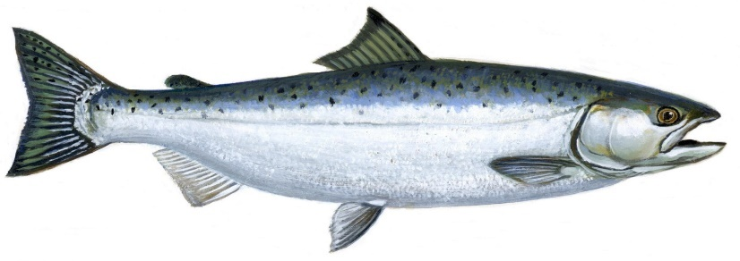
Salmon – Important to Coast Salish People
-main food source for aboriginal people who live on the coast
-abundant; caught in salt & fresh water
-used in trading & bartering with people from the interiors
-believed to have power & to be a gift to aboriginal people
-bones & fish remnants are a natural nourishment to the earth & were returned to the water or land

Slide 3
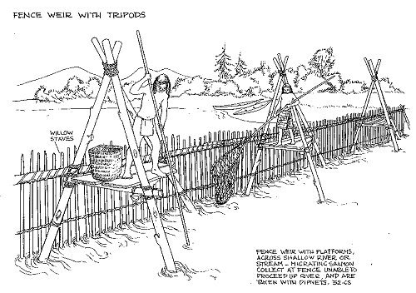
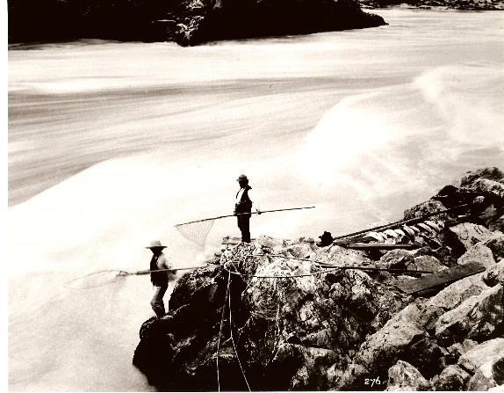
Salmon – Traditional Fishing Methods
Weirs & Traps were built to catch salmon in fast flowing rivers out of posts, some had a walkway for spearing or netting fish, and some included openings with boxes that would trap the fish
Dip Nets were used to catch various fish and were made from twine made from cedar bark & stinging nettle plant

Slide 4
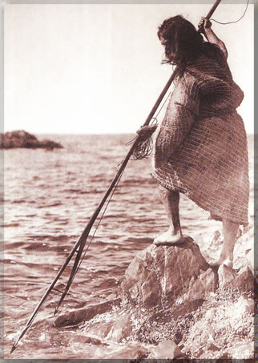
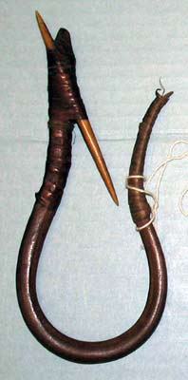
Salmon – Traditional Fishing Methods
Spears were used as salmon were making their way to spawning grounds
Hooks were made from natural materials
Children participated by trying to catch fish in shallow water with their bare hands
Boats & Nets were used in deep waters

Slide 5
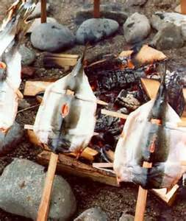
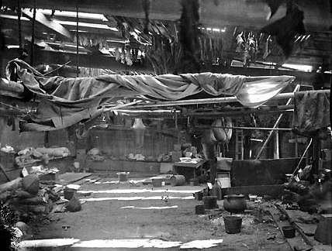
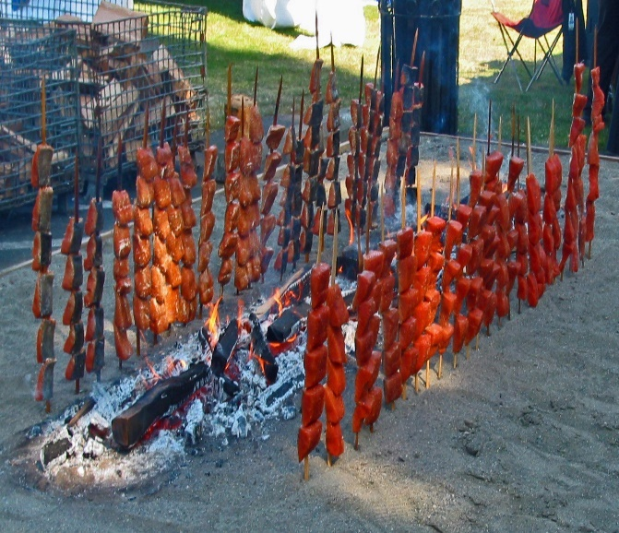
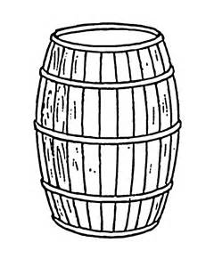
Salmon – Methods of Preparation
Smoked – head & tail removed, fillet spread flat and hung in smoke house. The size of smoke houses was determined by the size of the family & its use. Some smoke houses included fish, meat, and berries
Open Fire – cooked using stick of iron wood
Salted in Barrels - rock salt would be collected, crushed, & put into barrels between layers of fish. Sometimes salmon would be taken directly from the barrel and boiled to remove the strong salt taste; other times people would take the preserved (salted)salmon & smoke it

Slide 6
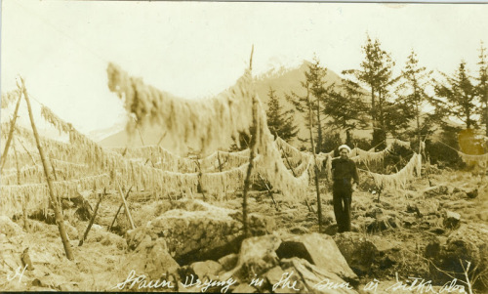
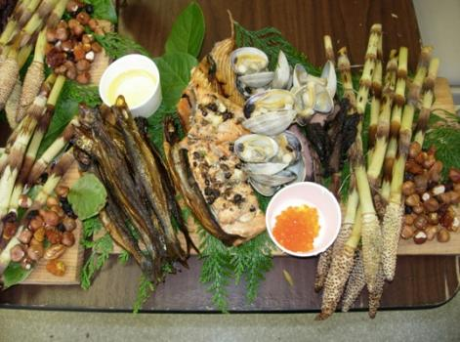
Salmon – Methods of Preparation
Sun & Wind Dried
Pit Cooking
As time progressed, cooking pots and marinating became more popular (wild berries)

