Slide 1
Learning is embedded in memory, history, & story
Brother Rick Peter

Slide 2
Memory, History, story:
Since the beginning of time, stories have been used to share information, teach lessons, provide entertainment, and record history.
They are an integral part of First Peoples’ culture and way of life.
Stories have been passed down orally through many generations.
They are learned through repetition and expressed verbally and visually.

Slide 3
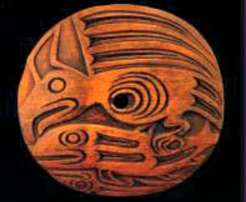
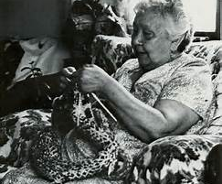
WAYS to express & invite interpretation
Spindle Whorls – used for spinning wool & depict a family story, creation story, or other
House Posts – tell family stories & communicate which family clans lived in particular longhouses
Masks - worn during ceremonies
*Items were carved from yellow & red cedar, juniper, alder, maple, and dogwood. They were painted with pigments from nature or left natural.
Knitting - the symbols represent items & when used together various stories are conveyed
*Knitting required a lot of focus and energy, and wool from various animals can be used.

Slide 4
Learning & Sharing through Music & Dance
DRUMS: beats and tempos transmit information & evoke emotion
SONGS & DANCES: songs & dances work together to tell stories. Some songs & dances are specific to family members. Some are used for special occasions
*Songs are learned by individuals practicing & learning with the guidance of elders. This is called Intergenerational Teaching.
“I have been part of a drum group since 1967. My dad and other elders were my mentors. Now I am a mentor to the Beecher Bay Drum Group.” Rick Peter
Quwut'sun Tzinquaw Dance Group 1972
https://www.youtube.com/watch?v=syGts_hFluQ

Slide 5
Knowledge the most valuable possession
“Historically, because ours was an oral society so there were no signed documents, members of the audience officially witnessed all significant agreements. The Speaker – whose role is that similar to a Master of Ceremonies – would call upon individuals to be the official witnesses to the agreement. Traditionally it would be two people from each village. To be a witness was a very important role: they would become the official record keepers; they would stand up at the end of the ceremony and provide their views; they would correct the discussion at future meetings; and they were obliged to pass on the details of the agreement to subsequent generations. They were considered very rich because knowledge was the most valued of all possessions.”
Retrieved on November 28, 2016 from http://www.cowichantribes.com/about-cowichan-tribes/history/origins/

Slide 6
Class Activity: think pair share
THINK:
Brother Rick shared the story of how he received his name. What is the story of your name? Or a nickname? Who named you? Why were you given your name? Do you feel your name contributes to your identity?
PAIR:
Share the story of your name, who named you, why were you given your name, and if you feel your name contributes to your identity with a partner
SHARE:
How were your name stories similar? Different?
Do you feel you know your partner better after listening to them?
Consider what life would be like without written word – how would you ensure historical events, family & community accounts, and other facts would be passed along to future generations?

