Slide 1
Storytelling
“Learning is embedded in memory, history, and story”
–First People’s Principle of Learning

Slide 2
How much do we rely on the written word? *Look I’m using it right now, to make it easier to communicate with you
To learn and teach?
To communicate?
To record?
To document or “make official”?
Think of 2 examples for each

Slide 3
Imagine that you didn’t have a written word, how would you do these things?
To learn and teach?
To communicate?
To record?
To document or “make official”?
Think of 1 example for each

Slide 4
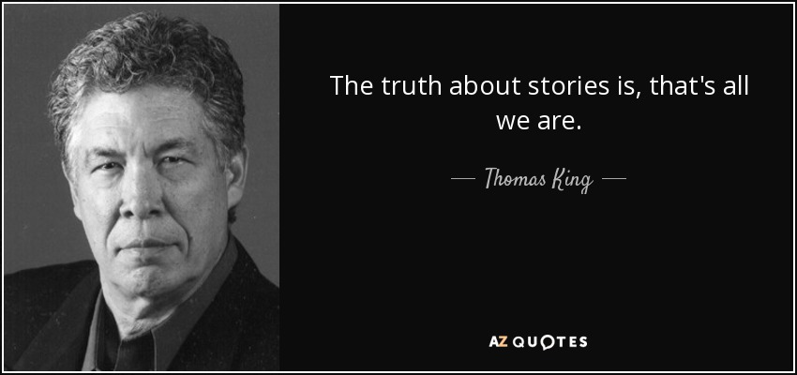
Stories can help do all of those jobs
When passed down through generations, they hold the history, the record, and teach lessons

Slide 5
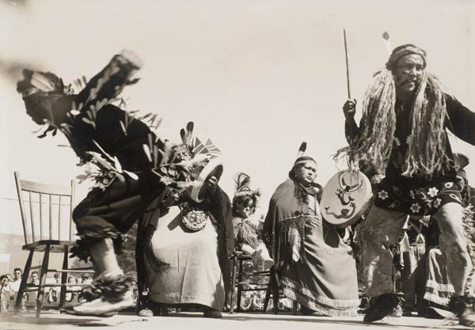
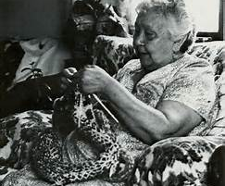
Stories are recorded in many ways
… told by memory and learnt through repetition, carved, weaved, knitted, sung, danced
Tzinquaw dancers, 1950, Cowichan Valley Museum
“Raven Stealing the Sun” Si-yaaxultun (Donald Smith)

Slide 6
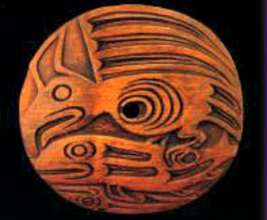
What is the story? Guesses?
Chief Swaletthul't'hw (Harvey Alphonse) and Kelly Antoine
Luke Marston, 2011
Douglas La Fortune

Slide 7
The Thunderbird and the Whale
What may be a purpose of this story?
http://www.vesicafilms.com/tbkw

Slide 8
Now it is your turn…Pick a story

Slide 9
Now it is your turn…Pick a story
Find your group
Read the story
Find a way to share it, without your audience reading it (you can still read it, as we are not skilled at remembering right away)
Examples: Retell it in a creative way (use the room, use voices, and different people), act it out, draw it out

Slide 10
Reflection
What lessons or histories could you see in the stories?
What challenges do you face with not using written word?

Slide 11
Connect and Share
“The truth about stories is, that’s all we are.” Do you agree or disagree with Thomas King? Why or Why not?
Do you have family stories that are passed down?

